Slide 1
Realty Decoded– Q2 FY’18
October 2017

Slide 2
Executive Summary
Q2 FY’18 was the first full quarter in the new RERA and GST regime and as expected both new launches and sales struggled in this quarter. On a year on year basis
  New launches dropped by 53% over Q2 FY’17
  Sales dropped by 18% over Q2 FY’17
  Inventory overhang increased to 42 months from 35 months in Q2 FY’17
Amongst the top 9 cities only Mumbai and Gurugram had shown improvement in both new launches and sales. Market in Gurugram was driven by affordable housing under Haryana Affordable Housing Policy 2013 and market in Mumbai benefited out of early implementation of RERA
Sales showed a marked improvement in September over July and August, driven by festival offers launched by most developers. Festival offers worked very well in Mumbai, Pune and Bangalore but could not yield similar results in Noida, Chennai and Hyderabad
Though overall sales dropped by 18%, ready to move in units sales have consistently grown at 21% annual rate whereas sales of under-construction units have de-grown at 22% annual rate over last 4 years. Even in under-construction units, sales of older projects have been better than newly launched
Ahmedabad and Chennai have highest share of ready to move in units in unsold stock
Units which were priced in the budget of <50 Lakhs contributed > 50% in new launches as well as in sales
Average prices are finally sloping upwards in Gurgaon, Mumbai and Hyderabad after a long stagnation

Slide 3

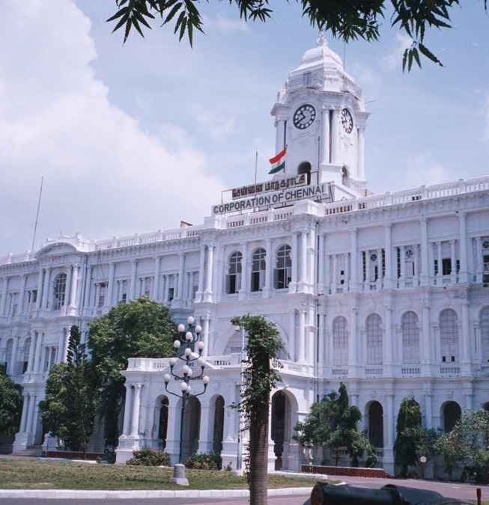
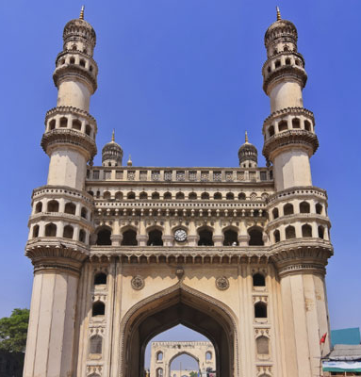


Residential Landscape: Top-9 cities as of Q2 FY’18
Pune and Noida witnessed steep increase in launches over the previous quarter. Except Gurgaon which saw few big affordable housing allotment, all other cities have seen decline in sales.
AHMEDABAD
Y-o-Y (%)
Launches | -91%
Sales | -46%
BSP | 2% (2,960)
Inventory Overhang | -72% (50)
BENGALURU
Y-o-Y (%)
Launches | -58%
Sales | -27%
BSP | 2% (4,926)
Inventory Overhang | -19% (37)
CHENNAI
Y-o-Y (%)
Launches | -91%
Sales | -23%
BSP | 1% (5,052)
Inventory Overhang | -58% (40)
GURUGRAM
Y-o-Y (%)
Launches | 85%
Sales | +60%
BSP | 9% (6,024)
Inventory Overhang | 47% (35)
HYDERABAD
Y-o-Y (%)
Launches | -89%
Sales | -18%
BSP | 4% (4,132)
Inventory Overhang | -39% (29)
KOLKATA
Y-o-Y (%)
Launches | -92%
Sales | -21%
BSP | -1% (3,831)
Inventory Overhang | -26% (39)
MUMBAI
Y-o-Y (%)
Launches | 19%
Sales | 6%
BSP | 4% (8,672)
Inventory Overhang | -26% (54)
NOIDA
Y-o-Y (%)
Launches | -51%
Sales | -29%
BSP | -2% (3,896)
Inventory Overhang | -26% (68)
PUNE
Y-o-Y (%)
Launches | -37%
Sales | -32%
BSP | 1% (4,952)
Inventory Overhang | -96% (45)
Notes:
1. Y-o-Y is comparison between the corresponding quarter of the previous year and the current quarter
2. BSP is represented in Rs./sq.ft.
3. Inventory overhang is represented in months.

Slide 4
Despite festival season, most key parameters were in red
Residential Trends in top-9 cities* Q-o-Q
Launches
14%
-8%
19%
-43%
-25%
Sales
-1%
-16%
13%
3%
-16%
Price Trend
0%
0%
-1%
1%
2%
Inventory Overhang
0%
23%
-16%
-5%
13%
Q2 FY’17
Q3 FY’17
Q4 FY’17
Q1 FY’18
Q2 FY’18
/
Strong/Marginal Decline
Stable
Strong/Marginal Increase
/
Notes: * Top 9 Cities are Mumbai (including Navi Mumbai & Thane), Pune, Noida (including Greater Noida & Yamuna Expressway), Gurugram (including Bhiwadi, Dharuhera & Sohna), Bengaluru, Chennai, Hyderabad, Kolkata and Ahmedabad.
Analysis includes apartments and villas across the regions.

Slide 5
1…………... Launches: RERA Continued To Impair Launches

Slide 6
Launches continued to be impacted by RERA and were 53% lower than Q2 FY’17
# of units
-25%
- 53%
Notes: * Top 9 Cities are Mumbai (including Navi Mumbai & Thane), Pune, Noida (including Greater Noida & Yamuna Expressway), Gurugram (including Bhiwadi, Dharuhera & Sohna), Bengaluru, Chennai, Hyderabad, Kolkata and Ahmedabad.
Analysis includes apartments and villas across the regions.

Slide 7
Except Mumbai & Gurugram, decline in launches was consistent across cities
# of units
Notes: * Noida includes Greater Noida and Yamuna Expressway.
** Mumbai includes Navi Mumbai and Thane.
^ Gurugram includes Bhiwadi, Dharuhera and Sohna.
Analysis includes apartments and villas across the regions.

Slide 8
After decline in Q1 FY’18, share of affordable housing again crossed 50% mark in Q2 FY’18
% of units
Notes: * Top 9 Cities are Mumbai (including Navi Mumbai & Thane), Pune, Noida (including Greater Noida & Yamuna Expressway), Gurugram (including Bhiwadi, Dharuhera & Sohna), Bengaluru, Chennai, Hyderabad, Kolkata and Ahmedabad.
Analysis includes apartments and villas across the regions.

Slide 9
2……Consumer & Demand :
Sales Momentum Subdued

Slide 10
Sales declined by 18% over the Q2 FY’17 primarily due to slow RERA registration
# of units
-16%
-18%
Notes: * Top 9 Cities are Mumbai (including Navi Mumbai & Thane), Pune, Noida (including Greater Noida & Yamuna Expressway), Gurugram (including Bhiwadi, Dharuhera & Sohna), Bengaluru, Chennai, Hyderabad, Kolkata and Ahmedabad.
Analysis includes apartments and villas across the regions.

Slide 11
Only Gurugram and Mumbai have shown improvement in sales compared to other cities
# of units
Notes: * Noida includes Greater Noida and Yamuna Expressway.
** Mumbai includes Navi Mumbai and Thane.
^ Gurugram includes Bhiwadi, Dharuhera and Sohna.
Analysis includes apartments and villas across the regions.

Slide 12
Sales of ready to move in units continued to grow unlike reduction in under-construction unit sales
# of units
CAGR
-22%
21%
Notes: * Top 9 Cities are Mumbai (including Navi Mumbai & Thane), Pune, Noida (including Greater Noida & Yamuna Expressway), Gurugram (including Bhiwadi, Dharuhera & Sohna), Bengaluru, Chennai, Hyderabad, Kolkata and Ahmedabad.
Analysis includes apartments and villas across the regions.

Slide 13
Even in under-construction units, sales improved in older projects compared to newly launched projects
Period | % Change (H1FY’18-o-H2 FY’17)
Units sold in ≤ 6 months old projects | -27%
Units sold in 7-12 months old projects | 16%
Units sold in > 12 months old projects | 14%
# of units
Notes: * Top 9 Cities are Mumbai (including Navi Mumbai & Thane), Pune, Noida (including Greater Noida & Yamuna Expressway), Gurugram (including Bhiwadi, Dharuhera & Sohna), Bengaluru, Chennai, Hyderabad, Kolkata and Ahmedabad.
Analysis includes apartments and villas across the regions.

Slide 14
< Rs. 50 Lakhs segment continued to play a larger role in sales
% of units
Notes: * Top 9 Cities are Mumbai (including Navi Mumbai & Thane), Pune, Noida (including Greater Noida & Yamuna Expressway), Gurugram (including Bhiwadi, Dharuhera & Sohna), Bengaluru, Chennai, Hyderabad, Kolkata and Ahmedabad.
Analysis includes apartments and villas across the regions.

Slide 15
Gurugram tops the charts for sales in < Rs. 25 Lakhs during the quarter owing to successful affordable housing policy
Budget-wise Sales in top-9* cities – Q2 FY’18
% of units
Notes: * Noida includes Greater Noida and Yamuna Expressway.
** Mumbai includes Navi Mumbai and Thane.
^ Gurugram includes Bhiwadi, Dharuhera and Sohna.
Analysis includes apartments and villas across the regions.

Slide 16
3………Inventory:
Inventory Overhang Erodes

Slide 17
Inventory overhang at the end of Q2 FY’18 increased to 42 months due to drop in sales during the quarter
# of months
5 months
Notes: * Top 9 Cities are Mumbai (including Navi Mumbai & Thane), Pune, Noida (including Greater Noida & Yamuna Expressway), Gurugram (including Bhiwadi, Dharuhera & Sohna), Bengaluru, Chennai, Hyderabad, Kolkata and Ahmedabad.
Analysis includes apartments and villas across the regions.

Slide 18
Hyderabad & Gurugram have the lowest inventory overhang at the end of Q2 FY’18
Age of unsold inventory vs inventory overhang in top-9* cities
(Sep’17)
Age of unsold
inventory (months)
Inventory overhang (months)
Notes: Notes: * Top 9 Cities are Mumbai (including Navi Mumbai & Thane), Pune, Noida (including Greater Noida & Yamuna Expressway), Gurugram (including Bhiwadi, Dharuhera & Sohna), Bengaluru, Chennai, Hyderabad, Kolkata and Ahmedabad.
Analysis includes apartments and villas across the regions.
Size of the bubble indicates total inventory in units.

Slide 19
Noida holds the highest share of unsold inventory aged above 3 years followed by Chennai & Gurugram
% of inventory
Age of unsold inventory in top-9 cities (Sep’17)
Notes: * Noida includes Greater Noida and Yamuna Expressway.
** Mumbai includes Navi Mumbai and Thane.
^ Gurugram includes Bhiwadi, Dharuhera and Sohna.
Analysis includes apartments and villas across the regions.

Slide 20
Kolkata and Ahmedabad have more than 70% of the unsold inventory in the <50 Lakhs segment followed by Pune
% of inventory
Budget breakup of unsold inventory (Sep’17)
Notes: * Noida includes Greater Noida and Yamuna Expressway.
** Mumbai includes Navi Mumbai and Thane.
^ Gurugram includes Bhiwadi, Dharuhera and Sohna.
Analysis includes apartments and villas across the regions.

Slide 21
Ahmedabad and Chennai have highest share of ready to move in units in unsold inventory
% of inventory
Notes: * Noida includes Greater Noida and Yamuna Expressway.
** Mumbai includes Navi Mumbai and Thane.
^ Gurugram includes Bhiwadi, Dharuhera and Sohna.
Analysis includes apartments and villas across the regions.

Slide 22
4…………………Pricing:
Positive Changes

Slide 23
Gurugram witnessed highest price appreciation followed by Mumbai and Hyderabad
Weighted average^^ BSP (Rs./sq.ft.) of apartment units as at the end of quarter
City | Q2 FY’17 | Q2 FY’18 | Price Change (Y-o-Y)
Ahmedabad | 2,912 | 2,960 | 2%
Bengaluru | 4,811 | 4,926 | 2%
Chennai | 4,998 | 5,052 | 1%
Gurugram^ | 5,525 | 6,024 | 9%
Hyderabad | 3,991 | 4,132 | 4%
Kolkata | 3,879 | 3,831 | -1%
Mumbai** | 8,349 | 8,672 | 4%
Noida* | 3,987 | 3,896 | -2%
Pune | 4,891 | 4,952 | 1%
Notes: ^^ Price weighted on number of units supply in respective projects in a city.
* Noida includes Greater Noida and Yamuna Expressway.
** Mumbai includes Navi Mumbai and Thane.
^ Gurugram includes Bhiwadi, Dharuhera and Sohna.
Analysis includes apartments across the regions.

Slide 24
Gurugram witnessed a sudden jump in the prices with 13% increase Q-o-Q
Weighted average price index of residential units in top-9* cities
Index value (Base: Q2 FY’15=100)
Notes: * Top 9 Cities are Mumbai (including Navi Mumbai & Thane), Pune, Noida (including Greater Noida & Yamuna Expressway), Gurugram (including Bhiwadi, Dharuhera & Sohna), Bengaluru, Chennai, Hyderabad, Kolkata and Ahmedabad.
Analysis includes apartments and villas across the regions.

Slide 25
Outlook for Q3 FY’18
We expect sales and new launches will show a growth of 30 – 40% on year on year basis in Q3 FY’18 primarily because of lower base of Q3 FY’17 (demonetization period) as well as improvement in customer confidence
States like Maharashtra where RERA has been effectively implemented will gain most with improving customer confidence
Many states have not yet started resolving customer grievances under RERA act or have come up with an effective RERA website. Such delays will hold back revival of customer confidence in these states
Effective rate of 12% of GST has been a dampener for the under-construction property buyer as developers have not been clear on input tax credit. Sector is expectantly looking forward to November GST council meeting to get some respite on the rate
Inclusion of immovable property in GST will be another big reform which can create short term hurdle in industry. Though this will be discussed in November GST council meeting but getting it through will not be that easy

